Slide 1


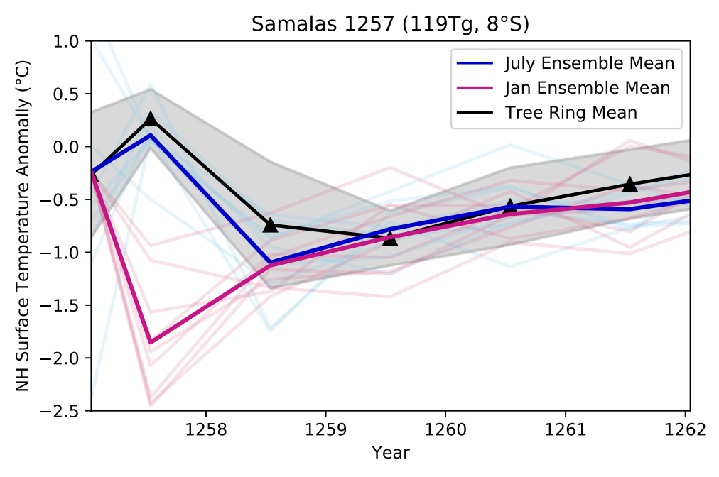
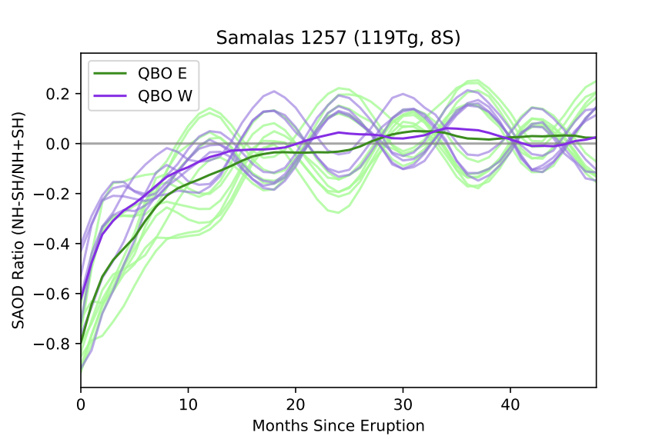
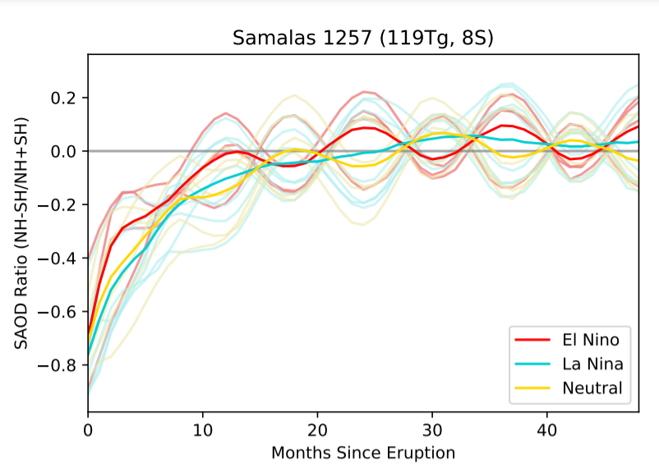
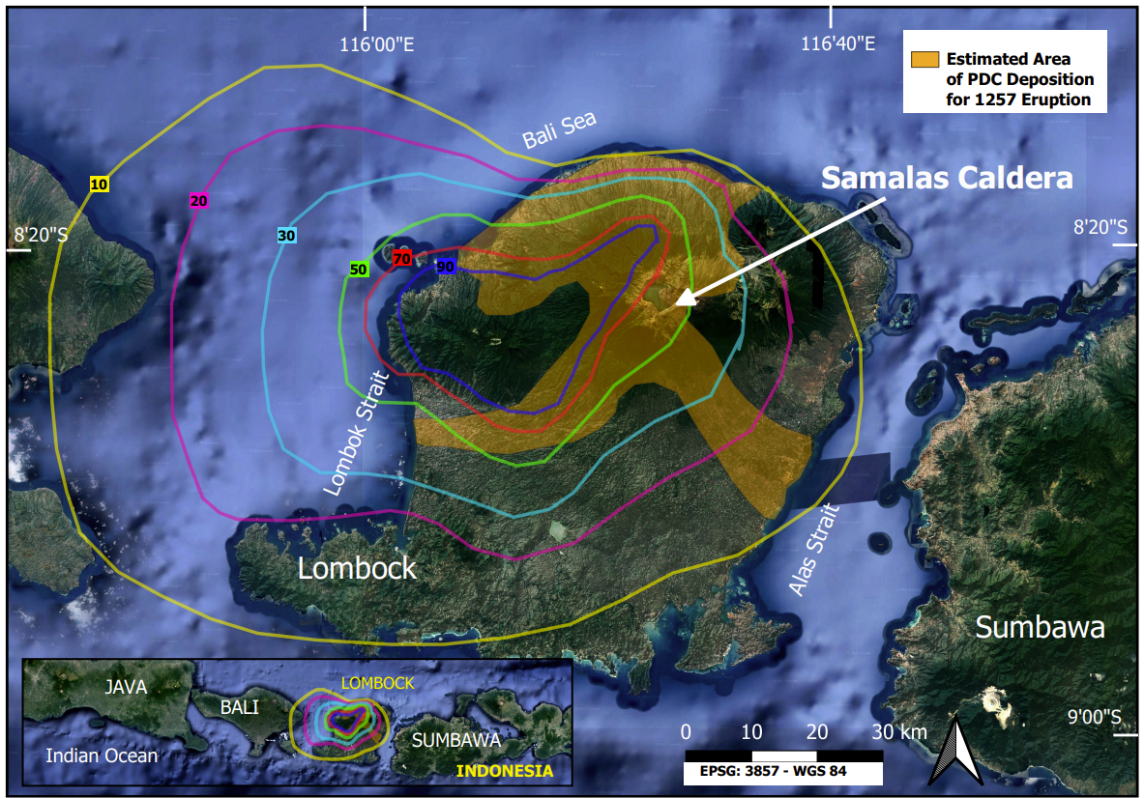
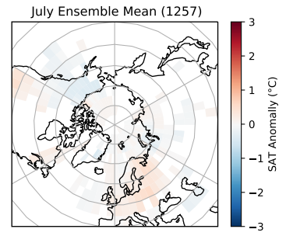
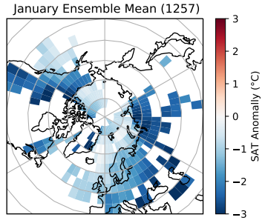
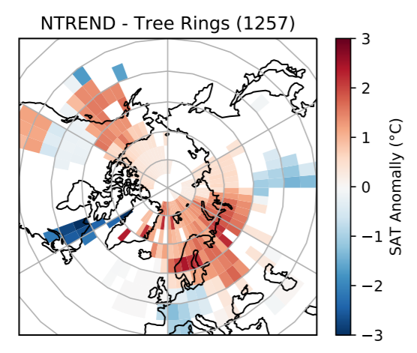
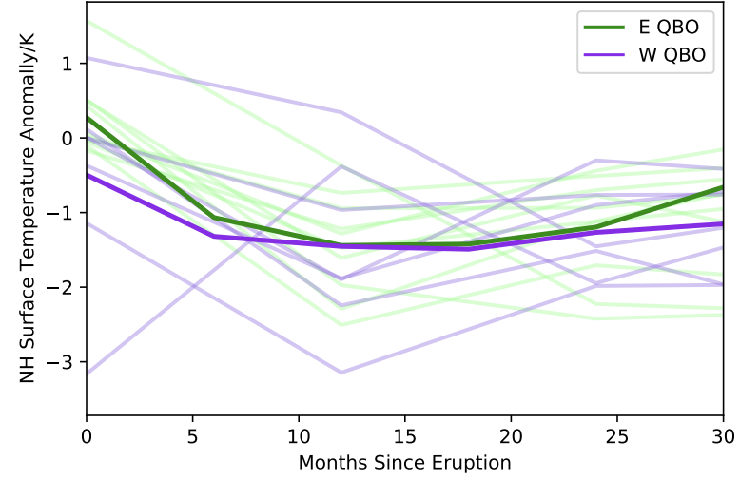
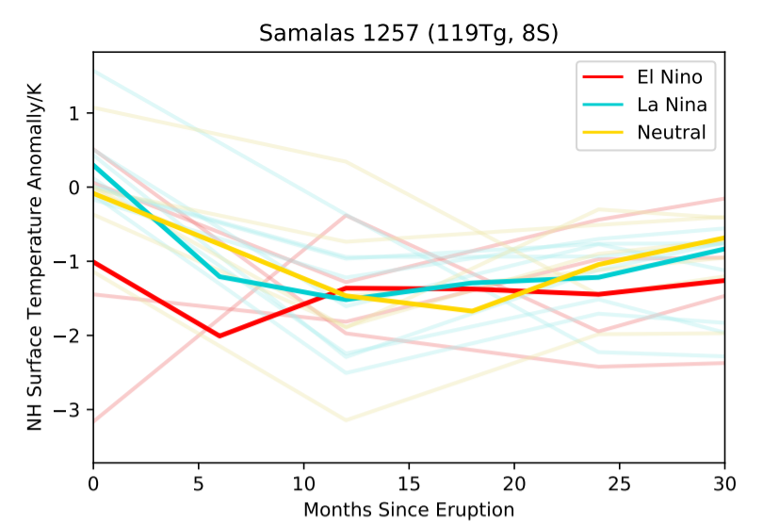
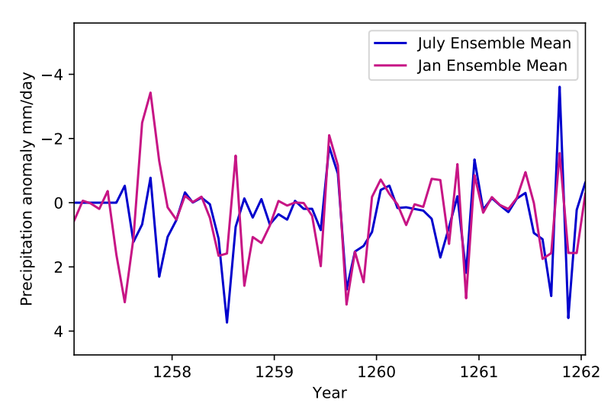
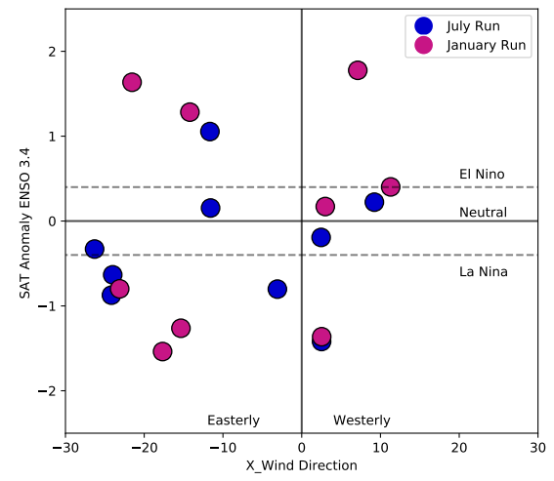
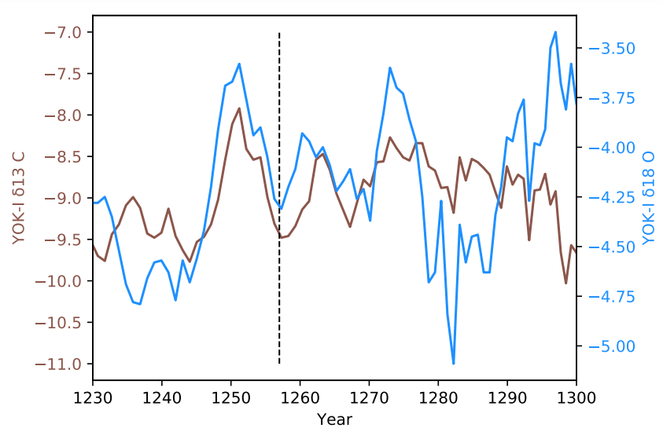

Constraining the Samalas Eruption: a Model and Multi-proxy Approach
Laura Wainman (She/Her)*¹, Lauren Marshall², Anja Schmidt^{2,3}
¹Department of Earth Sciences, University of Cambridge. ²Department of Chemistry, University of Cambridge. ³Department of Geography, University of Cambridge. *lw602@cam.ac.uk
Objectives:
[1] To place constraints on the timing of the Samalas Eruption using two modelled eruption scenarios (Jan/ July) and proxy records.
[2] To investigate the role of prior atmospheric conditions in modulating climatic impact, and where possible to place constraints on conditions at the point of the eruption.
3. Eruption Timing
3.4 Historical Records
Enhanced precipitation and cooler temperatures in Europe + unusual snowfall in Mongolia summer 1258.
July ensemble SAT anomalies agree with the onset of NH cooling in Summer 1258.
January ensembles show cooling in summer 1257 which is not reported in records.
3.1 Northern Hemisphere Mean SAT Anomalies
Include medieval chronicles and economic records (see Guillet et al,. 2017 and Stothers 2000).
Distribution shows a significant bias towards NH records, predominantly in Europe.
Key Result:
Mean July (blue) ensemble NH land SAT anomaly lies within two standard deviations of mean tree ring SAT anomaly (black).
Equivalent January (pink) ensemble NH land SAT anomaly falls outside of two standard deviations, with peak cooling being both too large and too early.
1. Introduction
The Samalas eruption was one of the largest eruptions of the Holocene epoch (VEI = 7), injecting ~ 120 Tg of SO₂ into the stratosphere.
The eruption had significant and regionally heterogenous impacts on global climate and has been invoked to explain a multitude of 13th century social/political/economic phenomena.
4. Atmospheric Modes*
Figure 7: Upper Left: SAOD hemispheric distribution by QBO initial condition. Upper Right: As above by ENSO starting condition.
Bottom Left: NH Land Surface Air Temperature anomaly by QBO starting condition. Bottom Right: As above by ENSO starting condition.
3.2 Spatially Resolved SAT Anomalies
Figure 3: Northern Hemisphere Land Surface Air Temperature Anomalies. Blue: July Ensemble Mean. Pink: January Ensemble Mean. Black line shows the mean of the SAT recorded in four tree ring chronologies. Grey band shows 2σ. Tree Ring data: Wilson et al., (2016), Schneider et al., (2015), Anchukaitis et al., (Personal Communication), Guillet et al., (2017)
Figure 1: Map showing the Samalas Caldera on the Island of Lombok, Indonesia. Overlain are the mapped PDC flows and Ash Isopachs for the 1257 Eruption. From Lavigne et al., (2013).
Note the dispersal of ash to the west relative to the caldera. This has been used to suggest prevailing easterly trade winds at the time of the eruption, indication a dry season/summer eruption.
Figure 4:
Top Left: July ensemble 1257 summer mean SAT anomaly.
Top right: January ensemble 1257 summer mean SAT anomaly.
Bottom Left: Spatially resolved NTREND SAT data. From Anchukaitis et al., (2017)
QBO and ENSO initial conditions modulate aerosol distribution between hemispheres. More rapid dispersion of aerosol to NH results in more extreme NH SAT cooling (as expected).
But analysis is limited by number of ensemble runs as there is a high degree of internal variability which may obscure starting condition signals.
January ensemble SAT anomalies overpredict cooling relative to spatially resolved tree ring data (on average by -2.3°C). July ensemble SAT anomalies show observed warming in Europe for 1257, although this is still cooler than observations (by -0.5 °C).
January and July ensembles both show significant cooling over Europe and Central Asia (1258-60). But fail to replicate the observed warming in Alaska recorded in the tree ring chronologies.
2. Methodology
Eruption Source Parameter | Ensemble Value
SO₂ Mass | 119 Tg
Injection Height | 18-20 km
Duration | 24hrs
Latitude | 8°S
18 UK Earth System Model (UKESM) ensemble runs.
9 simulating a January eruption, 9 simulating a July eruption (Fig 2).
Range of Quasi-Biennial Oscillation (QBO) and El Niño Southern Oscillation (ENSO) initial conditions (Fig 2).
Analysis of stratospheric aerosol optical depth (SAOD), temperature, and precipitation anomalies.
Constrained using historical sources, tree ring chronologies, and stalagmite records.
5. Conclusions and Future Work
3.3 Precipitation Anomalies*
Drier
Figure 6: Plot showing precipitation anomaly timeseries for Jan/July ensemble means for YOK-I grid box (15.625°S, 87.1875°W).
Both show a trend to wetter anomalies following the eruption. January ensemble mean shows a potential ITCZ reversal.
Global mean and spatially resolved SAT anomalies are best resolved by a July 1257 eruption scenario.
Modelled precipitation anomalies do not align with those observed in stalagmite records.
Starting atmospheric modes play a key role in hemispheric aerosol distribution which in turn modulates temperature response.
Future work will focus on the role of starting conditions in modulating ITCZ response, which may be linked to the occurrence of an El Niño-like event following the eruption.
Table 1: Constant Eruption Source Parameters and chosen values used in ensemble set up.
High-resolution Stalagmite record from Belize, Central America.
Preliminary results suggest drying is observed 1-5 years following the eruption but there is no clear volcanic signal in resulting ITCZ shift.
Wetter
Drier
Figure 5: Plot showing δ13C and δ18O records for YOK-I Stalagmite from Yok Balum Cave, Belize. Data from Kenneth et al., (2017).
January and July ensemble means show moderate wetting pattern following the eruption. With no significant long-term trend.
Ensemble runs suggest ITCZ shifts following the eruption. May be modulated by starting conditions and play a role in effecting ENSO response.
Figure 2: Plot showing ENSO and QBO initial conditions for each ensemble member.
Wetter
References →

